Slide 1
EMBEDDED SYSYEM DEVELOPMENT L.O3: DEVELOP EMBEDDED SOFTWARE (FIRMWARE)

Slide 2
Software Development: This refers to the process of creating computer programs or sets of instructions that tell a computer how to perform specific tasks.
Firmware: Firmware is a type of software that is closely tied to the hardware it runs on.
Developing embedded software, also known as firmware development, involves creating software that is specifically designed to run on embedded systems or to be executed on a specific device or hardware. This type of software is embedded into the device's firmware, which is a type of hardware that is designed to run the software permanently. The software typically controls various aspects of the device's functionality, such as input and output operations, data processing, and communication with other devices.

Slide 3
3.1. Designing Firmware Algorithm
Designing firmware algorithms involves creating a set of instructions that can be implemented in the firmware of a microcontroller or embedded system. This process typically includes creating pseudocode and flowcharts to represent the logic and flow of the algorithm.

Slide 4
Pseudocode
Pseudocode is a high level description of a computer program or algorithm that uses natural language mixed with some programming language like syntax.
Pseudocode is a high level description of the algorithm that uses human-readable syntax to represent the logic without adhering to a specific programming language

Slide 5
Nature: Pseudocode is a textual representation of an algorithm using a mix of natural language and simplified programming constructs.
Format: It is written in a language which is in human-readable form that outlines the logic of an algorithm.
Detail Level: It can be highly detailed or less detailed depending on the level of abstraction needed, but it focuses on describing the steps in a structured manner.
Use: Pseudocode is useful for planning and documenting algorithms, helping programmers understand the logic before writing actual code.
Flexibility: It allows for flexibility in expressing logic without being constrained by specific programming language syntax

Slide 6
Examples
Pseudocode for LED Blink with Arduino structure
void setup:
initialize LED_PIN as output
void loop:
turn_on(LED_PIN)
wait_for(seconds: 1)
turn_off(LED_PIN)
wait_for(seconds: 1)

Slide 7
In the above pseudocode:
1.void setup: This is a setup function that is typically called once at the beginning of the program. It's used for initialization tasks.
2.initialize LED_PIN as output: This line within void setup initializes a pin connected to an LED as an output.
3.void loop: This is a loop function that runs repeatedly after the setup function. It contains the main logic of your program.
The content within void loop represents the logic to turn the LED on, wait for 1 second, turn the LED off, and wait for 1 second, creating a blinking effect.

Slide 8
Pseudocode for Traffic Light:
void setup:
initialize RED_PIN as output
initialize YELLOW_PIN as output
initialize GREEN_PIN as output
void loop:
turn_on(RED_PIN)
wait_for(seconds: 5)
turn_off(RED_PIN)
turn_on(YELLOW_PIN)
wait_for(seconds: 2)
turn_off(YELLOW_PIN)
turn_on(GREEN_PIN)
wait_for(seconds: 5)
turn_off(GREEN_PIN)

Slide 9
In the above pseudocode:
void setup: This function is used for setup tasks and is typically called once at the beginning of the program. Here, we initialize pins for the red, yellow, and green lights as outputs.
void loop: This function contains the main logic of the program and runs repeatedly. In this case, it represents the sequence of actions for a simple traffic light. The traffic light sequence is as follows:
Turn on the red light for 5 seconds.
Turn off the red light.
Turn on the yellow light for 2 seconds.
Turn off the yellow light.
Turn on the green light for 5 seconds.
Turn off the green light.

Slide 10
Flowchart
A flowchart is a graphical representation of an algorithm that uses different shapes and symbols to represent various actions, decisions, and processes.
It provides a visual way to understand the flow of logic within an algorithm.

Slide 11
Nature: A flowchart is a graphical representation of an algorithm using standardized symbols and shapes to depict different steps, decisions, and processes.
Format: It is visual and hierarchical, using symbols like rectangles (for processes), diamonds (for decisions), and arrows (for flow direction) connected in a sequence to illustrate the algorithm's flow.
Detail Level: It provides a visual overview of the algorithm's structure, displaying the flow of control and decision points in a systematic manner.
Use: Flowcharts are beneficial for visualizing the flow of control within an algorithm, aiding in understanding complex processes and decision-making paths.
Representation: They depict the logic through graphical symbols, making it easier for stakeholders, including non-programmers, to comprehend the algorithm's flow.

Slide 12
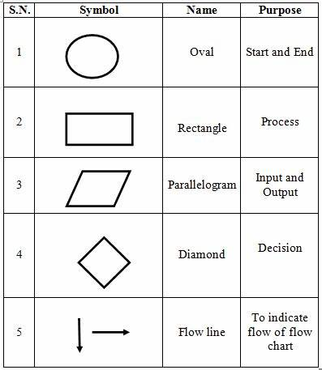
Flowchart Symbols with their meaning and explanation

Slide 13
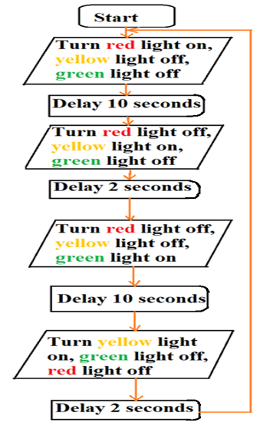
Example of flowchart for traffic light control

Slide 14
3.2.Building Firmware
Building firmware in the context of developing embedded software refers to the process of compiling and linking source code to create a binary file that can be loaded onto a microcontroller or other embedded system.

Slide 15
1.Setup Integrated Development Environment (IDEs)
Setting up Integrated Development Environments (IDEs) is crucial for programming microcontrollers, embedded systems, and various hardware projects. IDEs provide a comprehensive platform for coding, debugging, and uploading code to these devices.

Slide 16
a) Online IDEs (Atmel Studio, Mbed Studio)
Atmel Studio
Overview: Atmel Studio is an integrated development platform primarily used for programming Atmel microcontrollers, such as AVR and ARM-based chips.
Features: It offers advanced debugging capabilities, a rich set of libraries, and support for various Atmel hardware tools.
Setup: Atmel Studio generally requires you to download and install the software. It might need additional drivers or plugins depending on the hardware used.

Slide 17
How To Install Atmel Studio
Download the latest Atmel Studio installer from Atmel Studio 7 Latest Version for Windows & MacOS (atmega32-avr.com), or AVR® and SAM MCU Downloads Archive | Microchip Technology

Slide 18
Work
Question1:Download and install the following IDE
1.Online IDEs (Atmel Studio, Mbed Studio)
2.Offline IDEs (Arduino IDE, Thonny IDE, OpenMV)
After go in deep searching and work on how:
Importing libraries and boards
Writing codes:
Testing
Debugging
Question2: what are the advantages of Pseudocode and Flowchart in programming.
Question3:Write both pseudocode and flowchart for measuring temperature and humidity in environment with DHT11.

Slide 19
Conts,
Question 4: For your own choice select small project apart from what we learnt and do the following task:
Testing firmware :
✓ Running circuit simulation software
✓ Upload the firmware into controller
✓ Fix errors

Slide 20
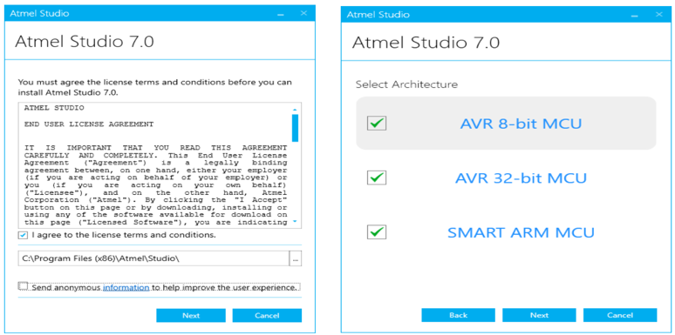
Install the framework and example projects
If everything is good, click next. Otherwise fix any issues listed

Slide 21
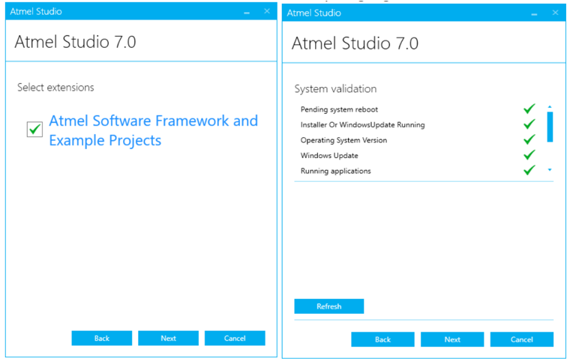
3.Click install, should take 30-40 minutes

Slide 22
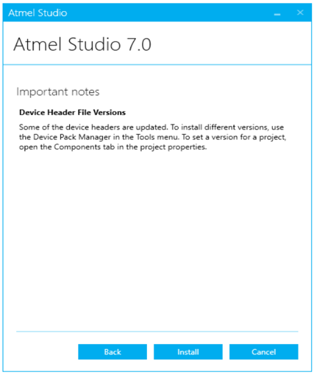
4.Install the drivers

Slide 23
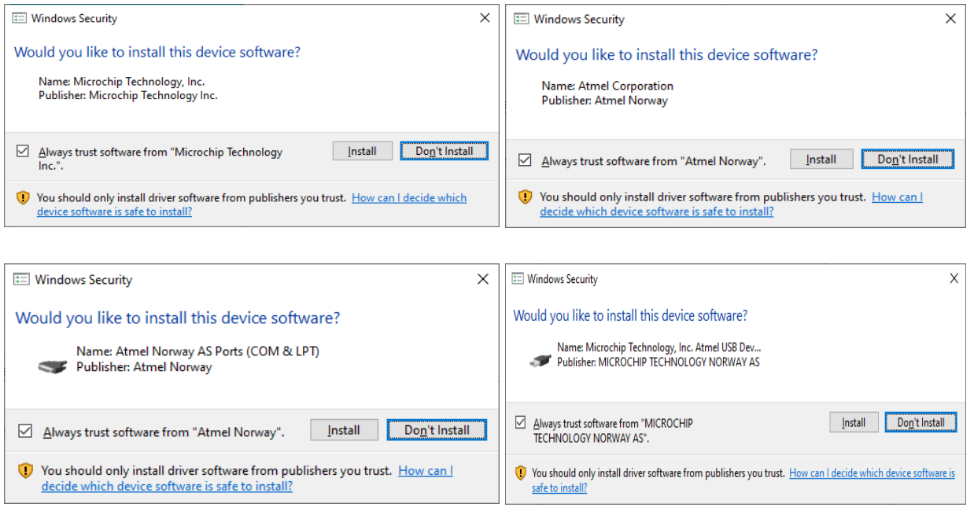

Slide 24
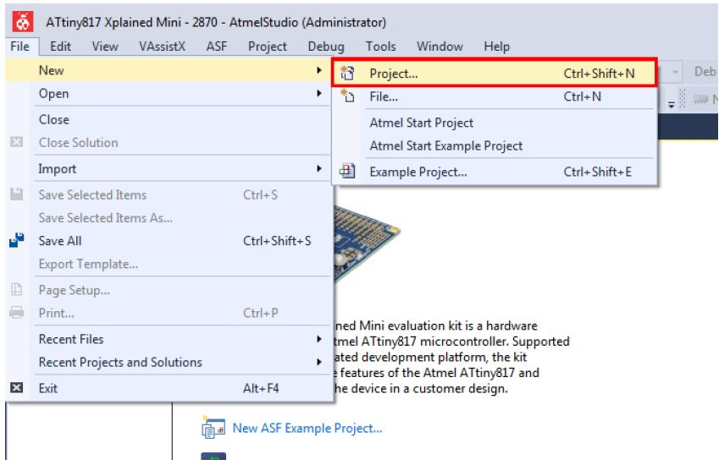
Creating a New Project
This section will outline the process of creating a new Atmel Studio project.
Open Atmel Studio.
In Atmel Studio, go to File → New → Project as depicted in Figure 1.
Figure 1. Creating a New Project in Atmel Studio

Slide 25
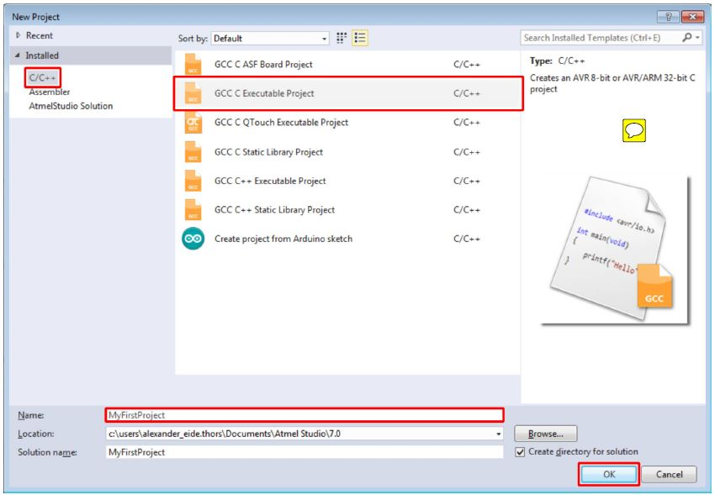
language and project template to be used. This project will use C, so make sure C/C++ is selected in the upper left corner. Select the GCC C Executable Project option from the template list to generate a bare-bones executable project. Give the project a Name and click OK. See Figure 2.

Slide 26
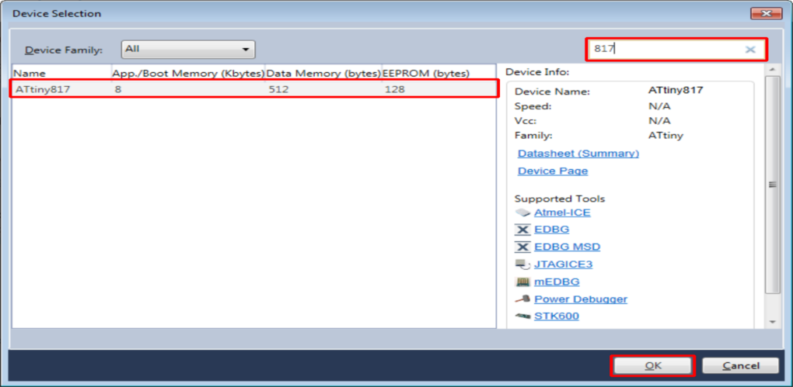
Next, it is necessary to specify which device the project will be developed for. A list of devices will be presented in the Device Selection dialog, which can be scrolled through, as depicted in Figure 3. It is possible to narrow the search by using the Device Family drop-down menu or by using the search box. This project will be developed for the ATtiny817 AVR device, so enter "817" in the search box in the top right corner. Select the ATtiny817 entry in the device list and confirm the device selection by clicking OK.

Slide 27
Offline IDEs (Arduino IDE, Thonny IDE, OpenMV)
Arduino IDE
Overview: Arduino IDE is one of the most popular platforms for programming Arduino boards (based on Atmel AVR and ARM processors).
Features: It's user-friendly, suitable for beginners, and supports a wide range of Arduino-compatible boards. It offers a simple interface and a vast community contributing libraries.
Setup: Download and install the Arduino IDE, select the appropriate board from the tools menu, and choose the correct port before uploading the code to the board.

Slide 28
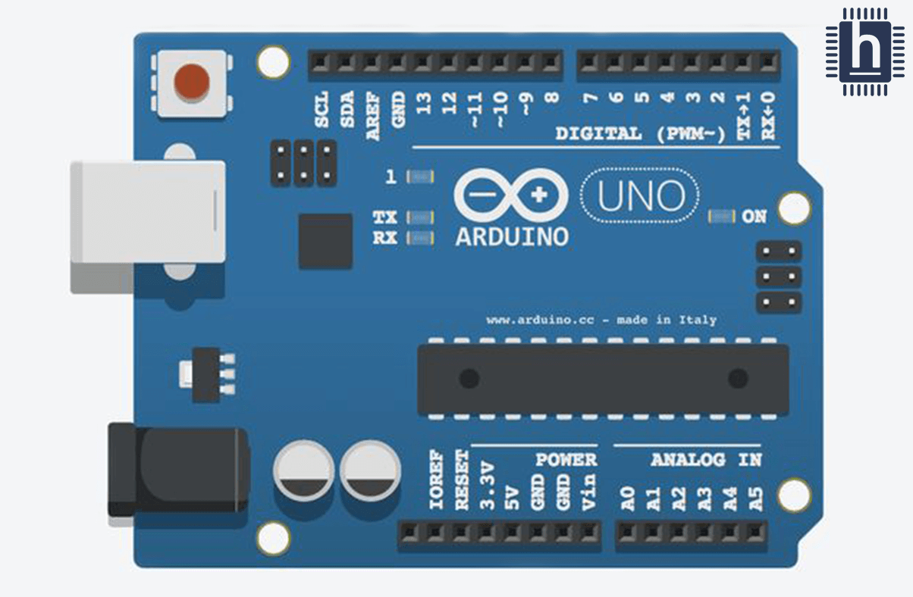
Conts,

Slide 29
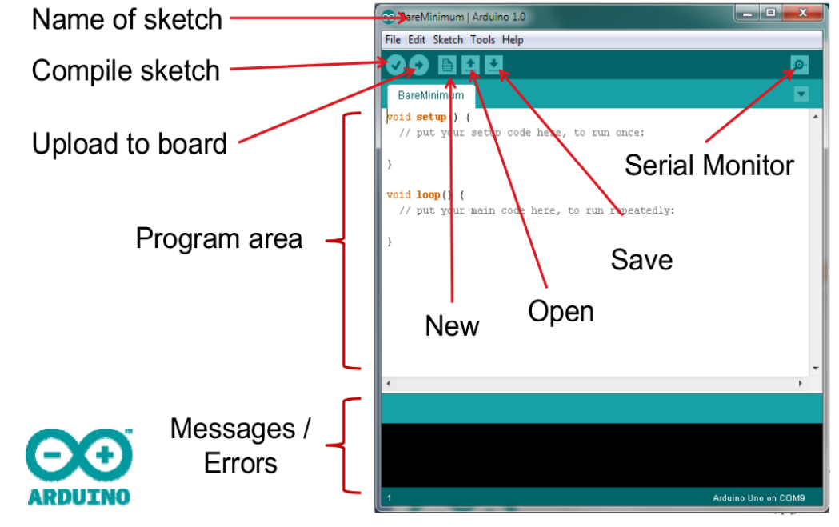
Arduino – Program Structure

Slide 30
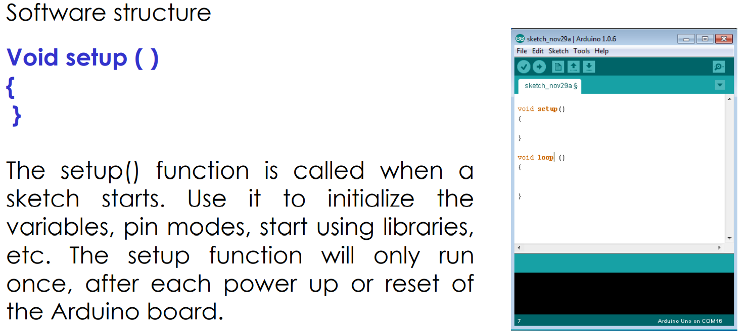

Slide 31
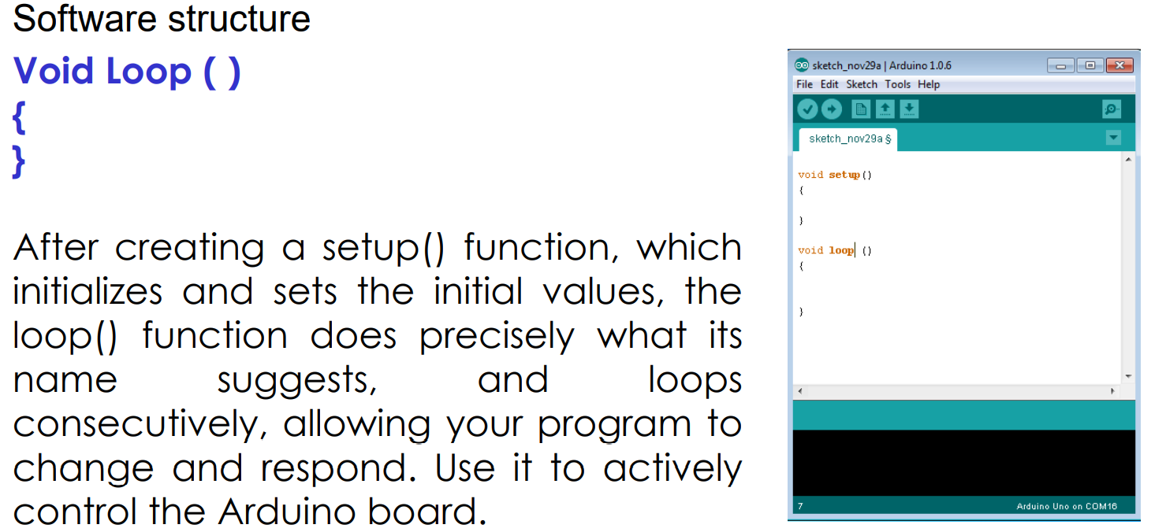

Slide 32
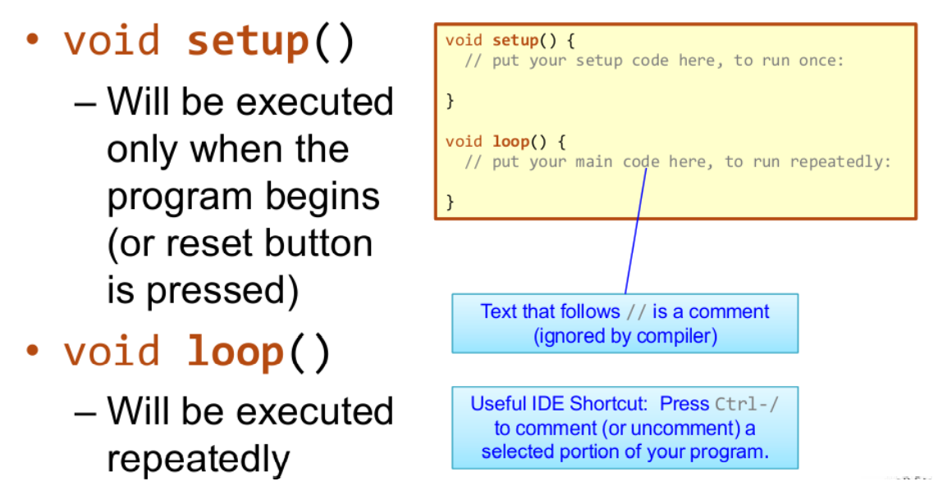

Slide 33
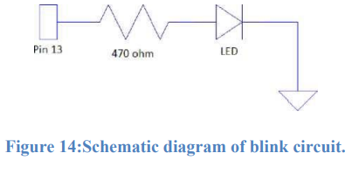
ACTIVITY1.
Connect an LED to a 470Q resistor. Note: that the longer leg of the LED is the positive (connected to one end of resistor and the shorter one is the negative (connected to the ground). The other end of the resistor should then be connected to the specified pin which is 13.

Slide 34
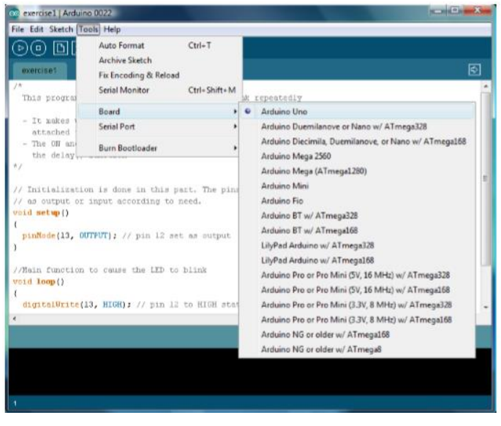
2. Check if the board selected in the IDE is the one you are using, the Arduino Uno board.

Slide 35
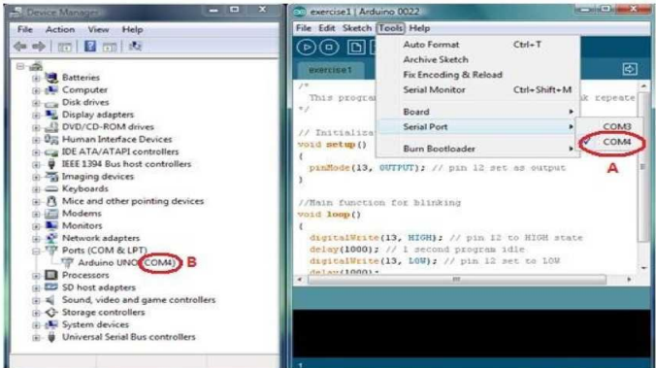
Next, make sure that the Arduino board’s COM port is properly identified by the IDE. To do this, connect the board to the computer then from the IDE front panel go to Tools > Serial Port .A list of COM’s should be there, choose the COM number associated with the microcontroller board. Note: the microcontroller board’s COM no. is found near the name of the device’s driver in Device Manager.

Slide 36
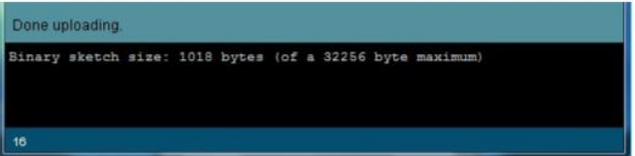
Finally, upload the sketch made earlier into the board by clicking the icon in the IDE. The status of the upload can be found near the bottom of the program.

Slide 37
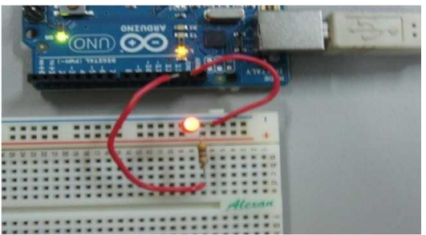
If the Arduino Uno is connected to the PC or power source the LED should light up for 1 second and turn off for 1 second repeatedly.

Slide 38
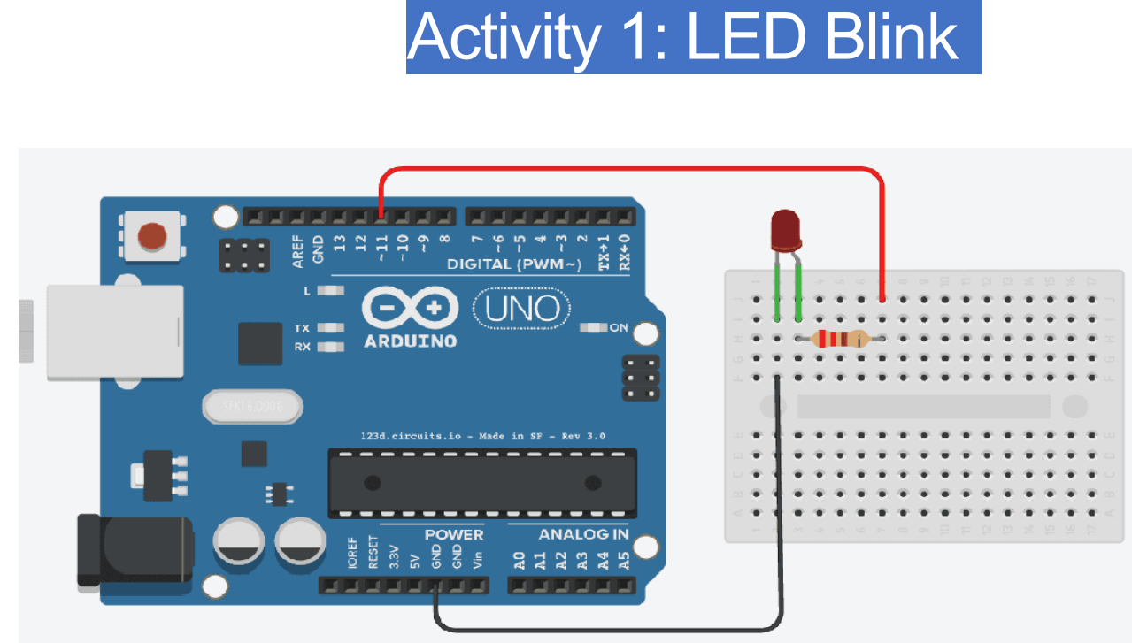

Slide 39
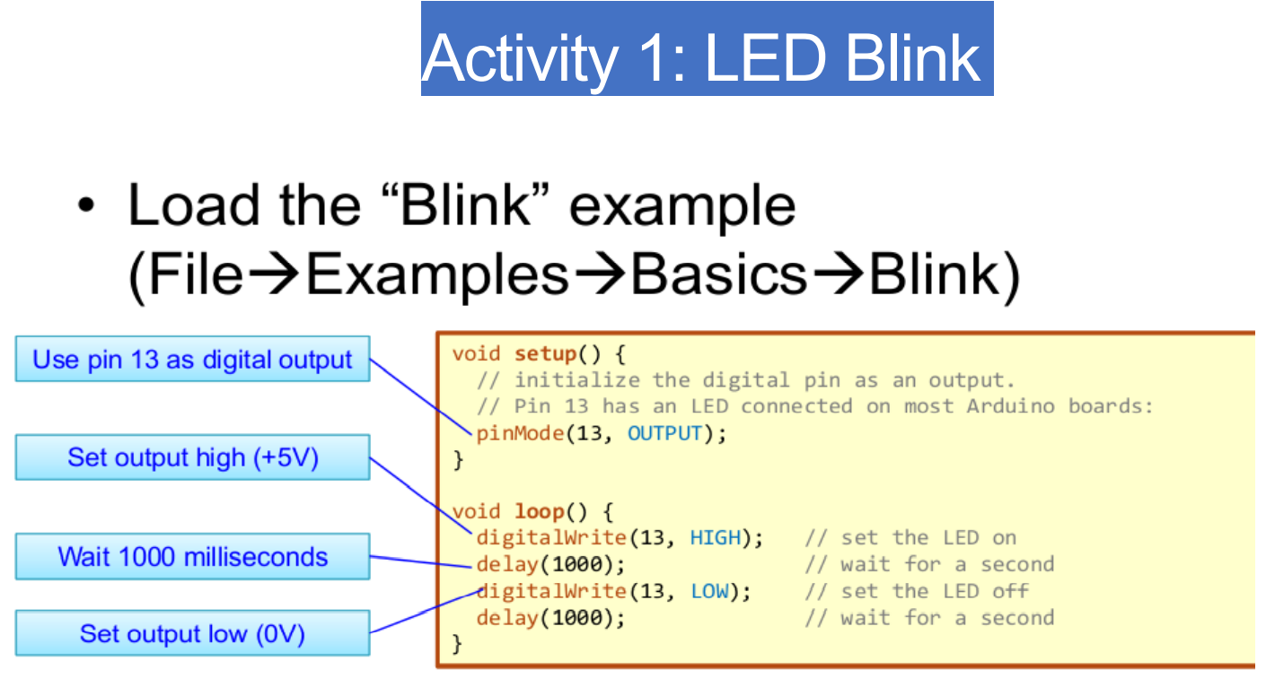

Slide 40
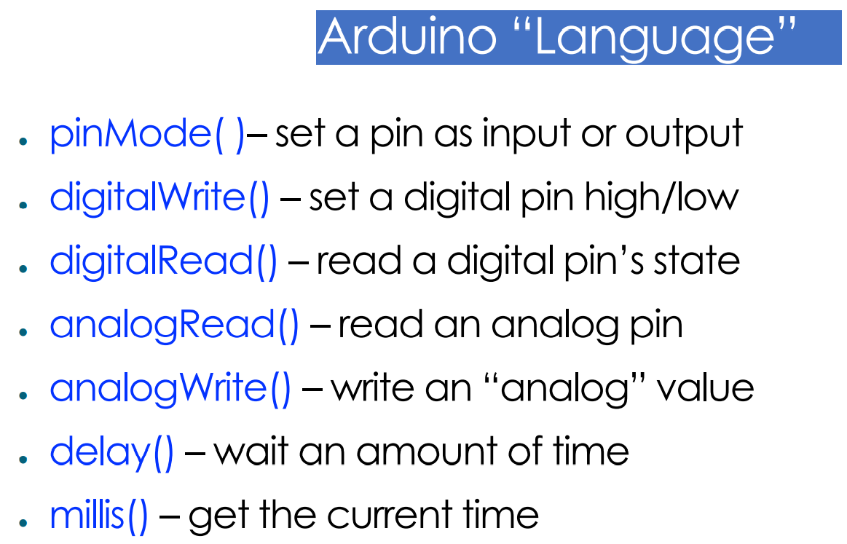

Slide 41
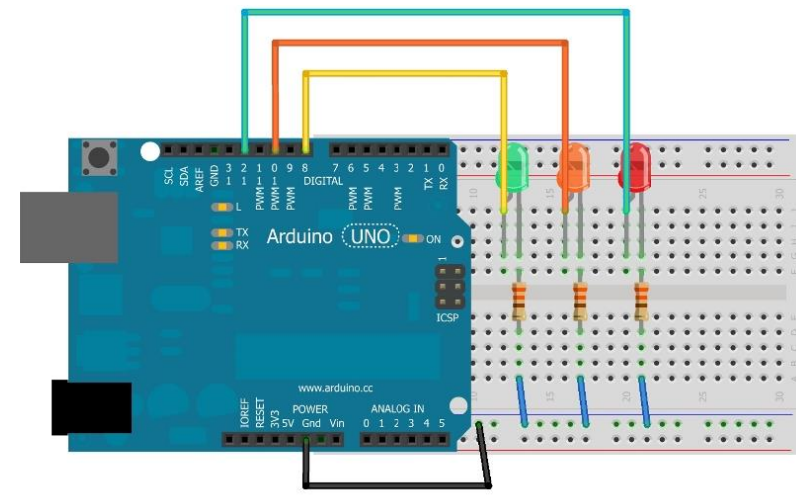
ACTIVITY2
Try for Traffic Light

Slide 42
Program code:
int redpin1=1;
int greenpin1=2;
int yellowpin1=3;
void setup()
{
pinMode(redpin1, OUTPUT);
pinMode(greenpin1,OUTPUT);
pinMode(yellowpin1,OUTPUT);

Slide 43
}
void loop()
{
digitalWrite(redpin1, HIGH);
delay(5000);
for(int i=0;i<30;i++){
digitalWrite(yellowpin1,HIGH);
delay(50);
digitalWrite(yellowpin1,LOW);
delay(50);
}

Slide 44
digitalWrite(redpin1, LOW);
digitalWrite(greenpin1, HIGH);
delay(5000);
for(int i=0;i<30;i++){
digitalWrite(yellowpin1,HIGH);
delay(50);
digitalWrite(yellowpin1,LOW);
delay(50);
}
digitalWrite(greenpin1, LOW);
}

Slide 45
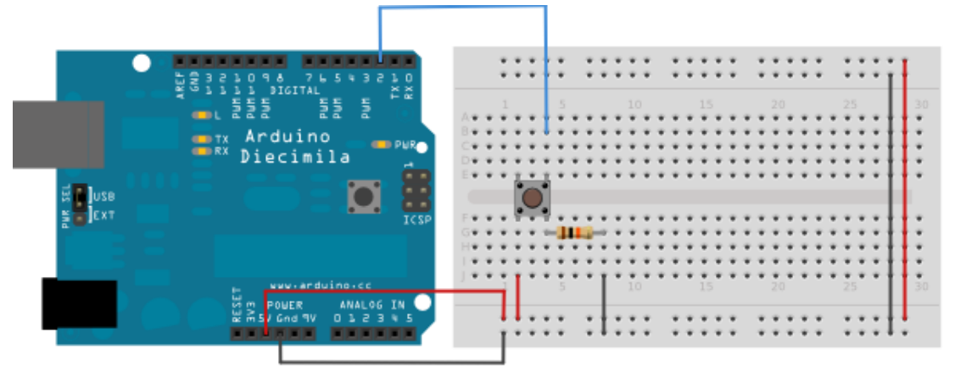
ACTIVITY 3:Basic Digital Input: Reading Pushbutton

Slide 46
Code
// constants won't change. They're used here to set pin numbers:
const i() {
// initialize the LED pin as an output:
pinMode(ledPin, OUTPUT);
// initialize the pushbutton pin as an input:
pinMode(buttonPin, INPUT);
}
void loop() {
// read the state of the pushbutton value:
buttonState = digitalRead(buttonPin);
// check if the pushbutton is pressed. If it is, the buttonState is HIGH:
if (buttonState == HIGH) {
// turn LED on:
digitalWrite(ledPin, HIGH);
nt buttonPin = 2; // the number of the pushbutton pin
const int ledPin = 13; // the number of the LED pin
// variables will change:
int buttonState = 0; // variable for reading the pushbutton status
void setup

Slide 47
} else {
// turn LED off:
digitalWrite(ledPin, LOW);
}
}

Slide 48
AVTIVITY 4:Experiment for DHT11 sensor
To complete task, you need the following components:
Arduino UNO
DHT11 temperature and humidity sensor
Breadboard
4.7k Ohm Resistor
Jumper wires

Slide 49
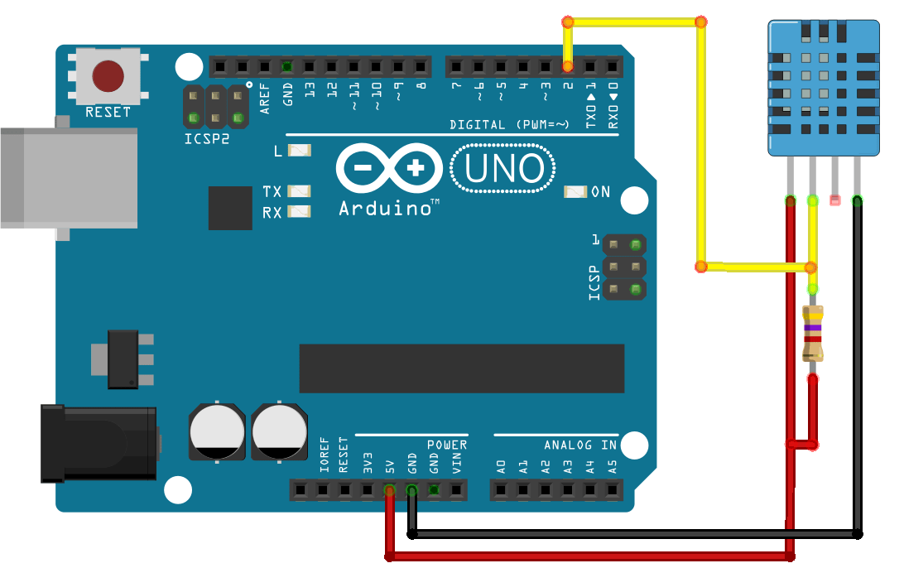
Schematic
Follow the next schematic diagram to wire the DHT11 (or DHT22) temperature and humidity sensor to the Arduino.

Slide 50
Installing Libraries
To read from the DHT sensor, we’ll use the DHT library from Adafruit. To use this library you also need to install the Adafruit Unified Sensor library. Follow the next steps to install those libraries.
Open your Arduino IDE and go to Sketch > Include Library > Manage Libraries. The Library Manager should open.
Search for “DHT” on the Search box and install the DHT library from Adafruit.

Slide 51
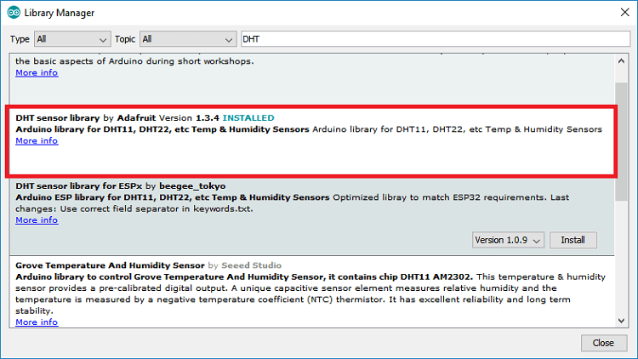

Slide 52
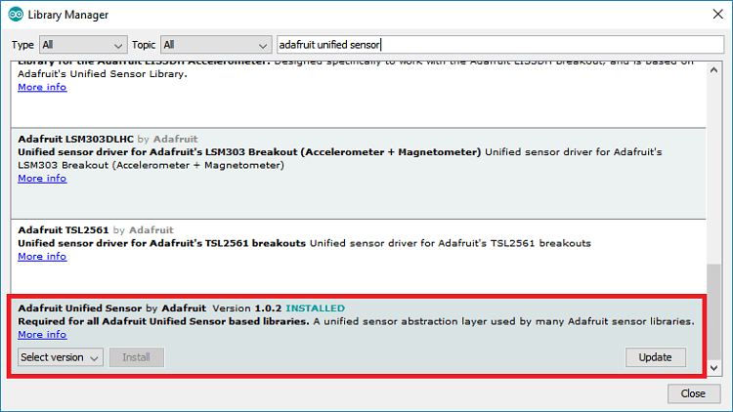
After installing the DHT library from Adafruit, type “Adafruit Unified Sensor” in the search box. Scroll all the way down to find the library and install it.
After installing the libraries, restart your Arduino IDE

Slide 53
Code
After installing the necessary libraries, you can upload an example code from the library.
In your Arduino IDE, go to File > Examples > DHT Sensor library > DHTtester
The following code should load. It reads temperature and humidity, and displays the results in the Serial Monitor.

Slide 54
#include "DHT.h"
#define DHTPIN 2 // what pin we're connected to
// Uncomment whatever type you're using!
#define DHTTYPE DHT11 // DHT 11
//#define DHTTYPE DHT22 // DHT 22 (AM2302)
//#define DHTTYPE DHT21 // DHT 21 (AM2301)
// Initialize DHT sensor for normal 16mhz Arduino
DHT dht(DHTPIN, DHTTYPE);
void setup() {
Serial.begin(9600);
Serial.println("DHTxx test!");
dht.begin();
}

Slide 55
void loop() {
// Wait a few seconds between measurements.
delay(2000);
// Reading temperature or humidity takes about 250 milliseconds!
// Sensor readings may also be up to 2 seconds 'old' (its a very slow sensor)
float h = dht.readHumidity();
// Read temperature as Celsius
float t = dht.readTemperature();
// Read temperature as Fahrenheit
float f = dht.readTemperature(true);
// Check if any reads failed and exit early (to try again).
if (isnan(h) || isnan(t) || isnan(f)) {
Serial.println("Failed to read from DHT sensor!");
return;
}
// Compute heat index
// Must send in temp in Fahrenheit!
float hi = dht.computeHeatIndex(f, h);

Slide 56
Serial.print("Humidity: ");
Serial.print(h);
Serial.print(" %\t");
Serial.print("Temperature: ");
Serial.print(t);
Serial.print(" *C ");
Serial.print(f);
Serial.print(" *F\t");
Serial.print("Heat index: ");
Serial.print(hi);
Serial.println(" *F");
}

Slide 57
2.Thonny IDE
Overview: Thonny is a beginner-friendly Python IDE often used for programming microcontrollers like Raspberry Pi or Micro Python-supported boards.
Features: It provides an easy-to-use interface, debugger, and Python shell, suitable for educational purposes and beginners learning Python programming.
Setup: Install Thonny, select the interpreter for the microcontroller or board, and start writing and executing Python code.

Slide 58
Lets talk about Raspberry
What is the Raspberry pi ?
Raspberry pi The Raspberry Pi is a low cost, credit-card sized computer that plugs into a computer monitor or TV, and uses a standard keyboard and mouse. It is a capable little device that enables people of all ages to explore computing, and to learn how to program in languages like Scratch and Python. It’s capable of 45 doing everything you’d expect a desktop computer to do, from browsing the internet and playing highdefinition video, to making spreadsheets, word-processing, and playing games.

Slide 59
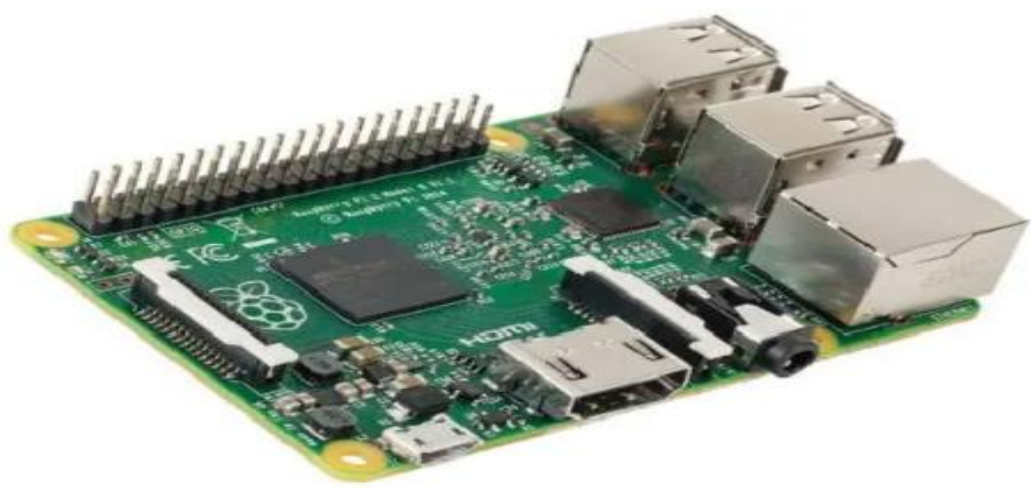

Slide 60
Raspberry Pi is a much popular device used in building IoT project.
The recently launched Raspberry Pi 3 includes built-in WiFi and Bluetooth making the most compact and standalone computer.
Conversely, since it is a computer, the Raspberry Pi runs an Operating System. That means that you can run multiple programs on it and you can run applications that use Internet services. It is actually a small computer, it runs Linux as operating system and has a full network system, solving thus the processing problem of the Arduino.

Slide 61
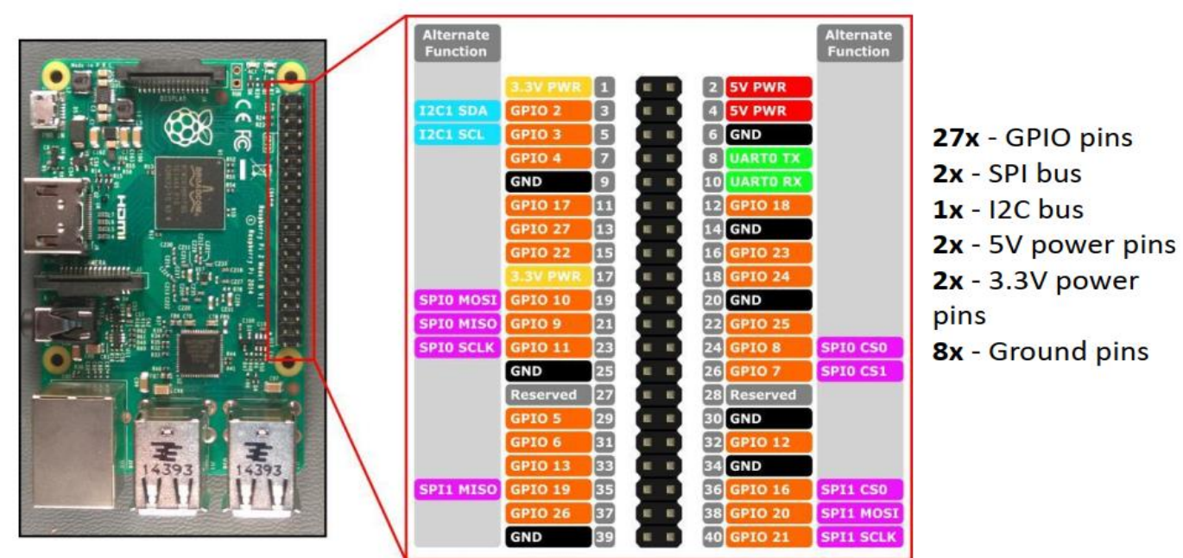
Pin detail

Slide 62
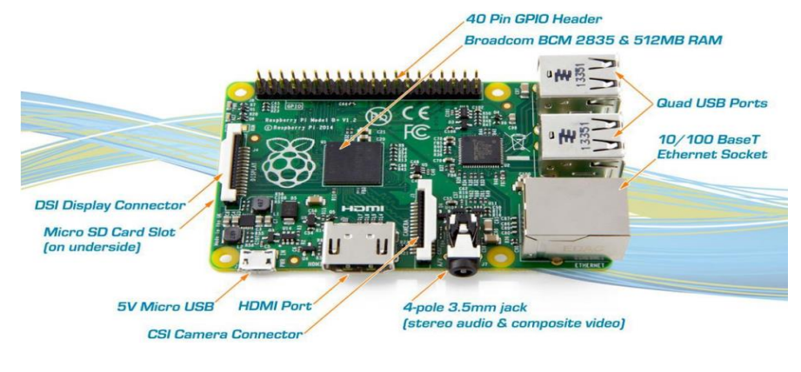

Slide 63
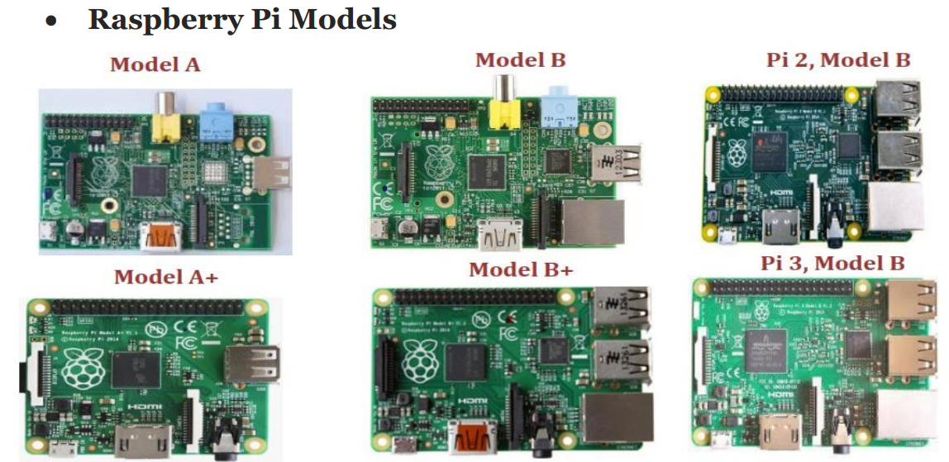

Slide 64
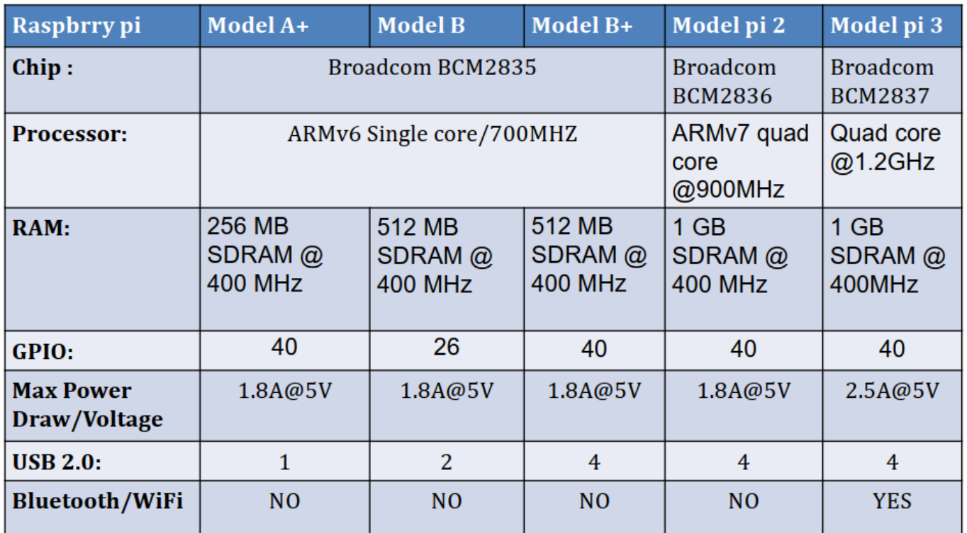
Comparison of Raspberry Pi Models

Slide 65
Basic requirement to setup Raspberry Pi
A Raspberry Pi computer with an SD card or micro SD card.
A monitor with a cable (and, if needed, an HDMI adaptor)
A USB keyboard and mouse.
A power supply/Power adapter
Headphones or speakers (optional)
An ethernet cable (optional)
SD card Reader

Slide 66
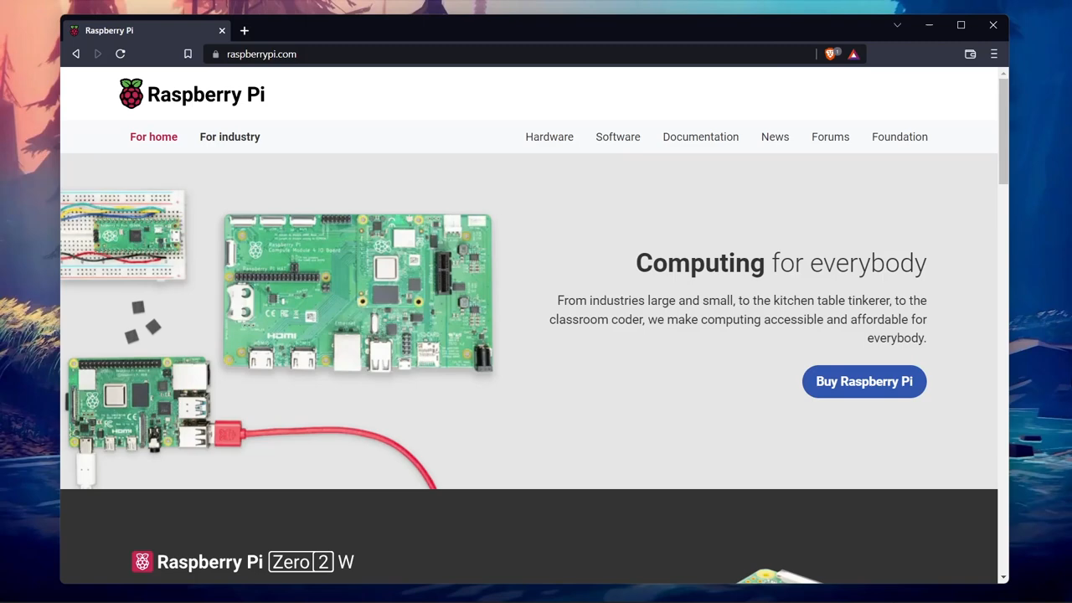
Installation(Follow this video)

